Slide 1

TIME MANAGEMENT & TASK ACHIEVER MOBILE APPLICATION

Slide 2
Table of Contents
01
Introduction
02
Literature Review
03
Methodology
04
Results & Discussions
05
Conclusion

Slide 3
Introduction
What is procrastination ?
A little bit of the background: procrastination ?
chronic self-destructive behaviour
promotes temporary comfort
delaying inevitable and unavoidable works
Types of Procrastination
Arousal
Favours the adrenaline rush on last minute
Believe it could push them to their limits
80%
Avoidant
Postponing the tasks on hand by creating several excuses
Fear of facing the inevitable
95%
Decisional
Having trouble making decision
Wasted most time on making decision
According to American Psychological Association up to 80 - 95% students are affected by it !

Slide 4
Introduction
01
02
Problem Statement: So what is the problem ?
Lost Track of Time !
Unable to Finish Work On Time !
The procrastination issue that is among everyday people, especially college students would
lose track of time and procrastinate to the extent of without ending.
It could lead to the outcome of unable to finish project on
time, or the result of the project not living up to expectation.

Slide 5

Introduction
Project Aim: What is this project trying to achieve ?
Cultivate Time Management Skill
.
By developing mobile-based application that allows user to cultivate time management skill, procrastination could be solved!
Develop an easy to use mobile-based time management application
Most importantly, solve procrastination!!!
.

Slide 6
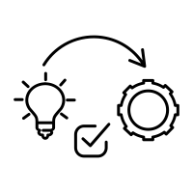



Introduction
Project Objectives: The milestones of the project
Research
Design
Implement
Evaluate
Research the technique of solving procrastination by cultivating balance working
habit through time management.
Design the mobile application with the most suitable method or solution
Implement a fully functioning mobile application according to the design
Evaluate the mobile application functionality on solving procrastination and ease of use quality

Slide 7
Introduction
Project Work Done: What has been done throughout this project ?
Research and Investigation
System Design
01
Research has been done in order to determine the most suited way for users of the
application to cultivate time management skill in order to solve procrastination
02
The system and its user interface as well as the flow of data has been
designed accordingly to the best suited solution
System Implementation
Evaluation
A fully functioning system has been created using Flutter framework combining with programming language
Dart implemented with Cloud Firestore database provided by Firebase Google
The system has been evaluated through testing and debugging for the purpose of
making sure the system is working perfectly
03
04

Slide 8
In Conclusion:
Solve procrastination that is wide among in society nowadays
So what is the long story shorted ?
Develop a mobile-based application that allows user to cultivating time management habit

Slide 9

Literature Review
Researching for the solution: What is it ?

Slide 10
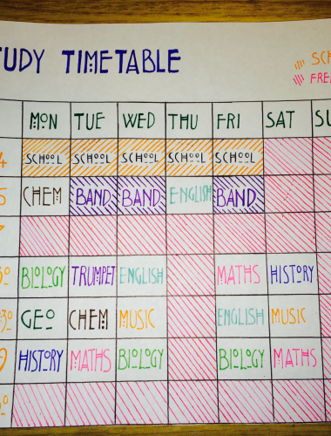
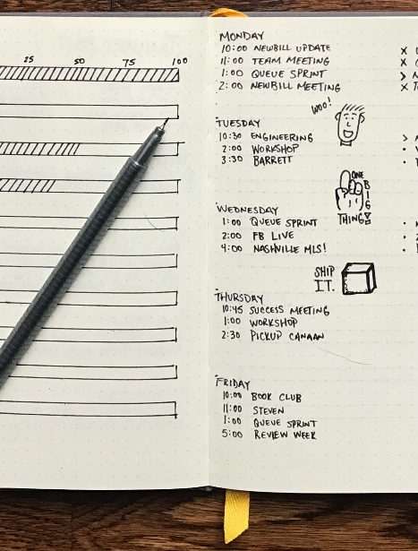

First of All:
What is Time Management ?
It can be defined as methods of utilizing the time that is available in your pocket effectively, especially investing it in work
Planning a certain amount of time that you will spending on certain activities
Some examples :

Slide 11
Secondly:
What is Habit?
Crucial foundation for practice or activity of productivity
Once the habit emerges, the brain stops fully participating in decision making
Due to neurological cravings, we could force ourselves into activities that might seem like a hassle which we have cultivated as habits
In conclusion : a certain activities that your brain craves after being exposed to a long period of time

Slide 12

Time Management Habit
=
Time Management
+
Habits
Incorporate a sense of clockwork into your lifestyle
help you keep your work within deadlines and avoid running late
Continuously feeding the brain and body the activities of managing time in order to build up the neurological craving

Slide 13
Literature Review
A tool that can provide the function of helping people cultivating habit by providing the means and motivation of encouraging people to follow through with a pre-fix timetable could benefit people from cultivating a time management habit
Cultivating habitual time management skill is a great way to reduce procrastination
In conclusion:

Slide 14
Methodology
The method of developing the application

Slide 15
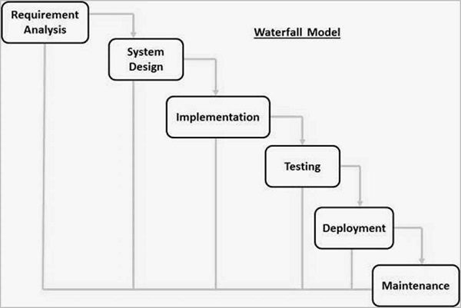
Methodology
Software Development Life Cycle Methodology: Waterfall

Slide 16

The Steps of Waterfall Methodology
What does each step means ?
System Requirement Analysis: Information about procrastination being gathered
System Design: General flow of the system and the layout have been designed
System Implementation: System being created and implemented into something user can interact with
System Testing: Performing a series of use cases simulation and the outputs were recorded
System Evaluation: Recruit 10 testers and record their feedbacks

Slide 17
Results & Discussions
Results of developing the application

Slide 18
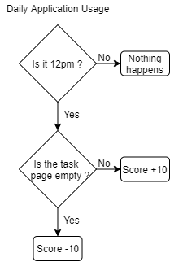
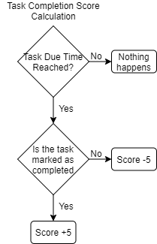
Results & Discussions
System Requirement Gathering : System Solution
Task Completion Score
Daily Usage Score

Slide 19
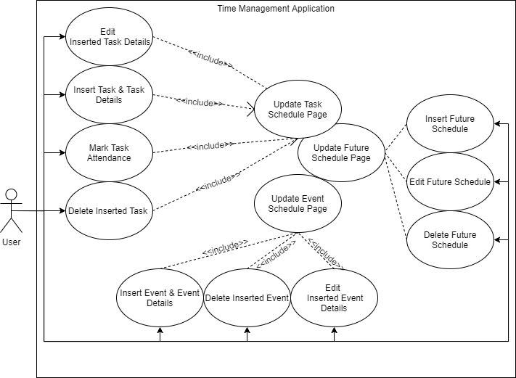
Results & Discussions
System Requirement Gathering : Use Case Diagrams

Slide 20
Results & Discussions
System Requirement Gathering : Use Case 1
Use Case Name | Insert Task & Task Details
Use Case Description | A user inserts task and task details of the day to the system
Actors | Users
Pre-condition | The user must have a task that he wants it to be completed by the end of the day.
Post-condition | Task will be inserted to the Task Schedule Page
Steps | Main Scenario
1 2 3 4 5 | Insert Task Name Insert Task Description Insert Task Due Time Insert Priority Task added to the Task Schedule Page according to the information inserted by the user.
Extensions Steps | Extensions Scenario
1a 2a 3a | User did not insert Task Name; shows error message User did not insert Task Description; ignored as it is optional User did not insert Task Due Time; shows error message

Slide 21
Results & Discussions
System Requirement Gathering : Use Case 2
Use Case Name | Edit Task & Task Details
Use Case Description | A user edits a specific task and task details
Actors | Users
Pre-condition | The user desires to modify a certain detail of a specific task.
Post-condition | Edited task will be updated with the newly inserted information
Steps | Main Scenario
1 2 3 4 5 | Insert New Task Name Insert New Task Description Insert New Task Due Time Insert New Priority Edited Task with newly inserted information displayed on Task Schedule Page
Extensions Steps | Extensions Scenario
1a 2a 3a | User did not insert Task Name; shows error message User did not insert Task Description; ignored as it is optional User did not insert Task Due Time; shows error message

Slide 22
Results & Discussions
System Requirement Gathering : Use Case 3
Use Case Name | Mark Task Attendance
Use Case Description | A user marks the attendance of a task which shows that he is going to carry out the task
Actors | Users
Pre-condition | The system must have a task that is scheduled
Post-condition | The task attendance will be marked, and punishment will be avoided
Steps | Main Scenario
1 | Mark Task Attendance
Extensions Steps | Extensions Scenario
1a | User failed to mark attendance; score decreases

Slide 23
Results & Discussions
System Requirement Gathering : Use Case 4
Use Case Name | Delete Inserted Task
Use Case Description | A user wants to delete an inserted task when the task is no longer needed to be completed by the day
Actors | Users
Pre-condition | There must an inserted task
Post-condition | Task will be deleted from schedule
Steps | Main Scenario
1 | User selects the task User selects the delete task option

Slide 24
Results & Discussions
System Requirement Gathering : Use Case 5
Use Case Name | Insert Event
Use Case Description | A user inserts an Event to the Event Schedule Page.
Actors | Users
Pre-condition | The user must have an event of which the user must attend or participate
Post-condition | Event will be inserted to the Event Schedule Page
Steps | Main Scenario
1 | Insert Event Name
2 | Insert Event Description
3 | Select Event Start Time and End Time
Extensions Steps | Extensions Scenario
1a | User did not insert Event Name; shows error message
2a | User did not insert Event Description; ignored as it is optional
3a | User did not insert Evet Start and End time; shows error message

Slide 25
Results & Discussions
System Requirement Gathering : Use Case 6
Use Case Name | Delete Inserted Event
Use Case Description | A user wants to delete an inserted event when the event is no longer needed to be participated or attended
Actors | Users
Pre-condition | There must an inserted event
Post-condition | Event will be deleted from Event Schedule Page
Steps | Main Scenario
1 2 | User selects event User selects the delete event option

Slide 26
Results & Discussions
System Requirement Gathering : Use Case 7
Use Case Name | Edit Event & Event Details
Use Case Description | A user edits a specific event and its details
Actors | Users
Pre-condition | The user desires to modify a certain detail of a specific event.
Post-condition | Edited event will be updated with the newly inserted information
Steps | Main Scenario
1 2 3 4 | Insert New Event Name Insert New Event Description Select New Event Start Time and End Time Edited Event with newly inserted information displayed on Event Schedule Page
Extensions Steps | Extensions Scenario
1a 2a 3a | User did not insert Event Name; shows error message User did not insert Task Description; ignored as it is optional User did not insert Event Start Time/ End Time; shows error message

Slide 27
Results & Discussions
System Requirement Gathering : Use Case 8
Use Case Name | Update Task Schedule Page
Use Case Description | The Task Schedule Page updates with newly inserted information or removed information
Actors | Users
Pre-condition | User has a change in the schedule of the day
Post-condition | Task Schedule Page updated
Steps | Main Scenario
1 1(2) 1(3) 1(4) | User Insert Task & Task Details User Marks Task Attendance User Delete Inserted Task User Edit Task & Task Details
Extensions Steps | Extensions Scenario
- | -

Slide 28
Results & Discussions
System Requirement Gathering : Use Case 9
Use Case Name | Update Event Schedule Page
Use Case Description | The Event Schedule Page updates with newly inserted information or removed information
Actors | Users
Pre-condition | User has a change in the schedule of the day
Post-condition | Event Schedule Page updated
Steps | Main Scenario
1 1(2) 1(3) | User Insert Event & Event Details User Delete Event User Edit Event & Event Details
Extensions Steps | Extensions Scenario
- | -

Slide 29
Results & Discussions
System Requirement Gathering : Use Case 10
Use Case Name | Insert Future Schedule
Use Case Description | A user inserts an event that is scheduled in the future (event that does not occur in the current day)
Actors | Users
Pre-condition | The user must have an event of which the user must attend or participate in the future
Post-condition | Event will be inserted to the Future Schedule Page
Steps | Main Scenario
1 | Insert Future Schedule Name
2 | Insert Future Schedule Description
3 | Select Event Date and Time
Extensions Steps | Extensions Scenario
1a | User did not insert Future Schedule Name; shows error message
2a | User did not insert Future Schedule Description; ignored as it is optional
3a | User did not insert Future Schedule Date and Time; shows error message

Slide 30
Results & Discussions
System Requirement Gathering : Use Case 11
Use Case Name | Edit Future Schedule & Future Schedule Details
Use Case Description | A user edits a specific future schedule and its details
Actors | Users
Pre-condition | The user desires to modify a certain detail of a specific task.
Post-condition | Edited task will be updated with the newly inserted information
Steps | Main Scenario
1 2 3 | Insert New Future Schedule Name Insert New Future Schedule Description Select New Future Schedule Date and Time
Extensions Steps | Extensions Scenario
1a 2a 3a | User did not insert Future Schedule Name; shows error message User did not insert Future Schedule Description; ignored as it is optional User did not insert Future Schedule Date and Time; shows error message

Slide 31
Results & Discussions
System Requirement Gathering : Use Case 12
Use Case Name | Delete Inserted Future Schedule
Use Case Description | A user wants to delete an inserted event scheduled in the future when the event is no longer needed to be participated or attended
Actors | Users
Pre-condition | There must an inserted future schedule
Post-condition | Event will be deleted from Event Schedule Page
Steps | Main Scenario
1 | User selects delete future schedule option from a specific future schedule

Slide 32
Results & Discussions
System Requirement Gathering : Use Case 13
Use Case Name | Update Future Schedule Page
Use Case Description | The Future Schedule Page updates with newly inserted information or removed information
Actors | Users
Pre-condition | User has a change in the schedule in the future
Post-condition | Future Schedule Page updated
Steps | Main Scenario
1 1(2) 1(3) | User Insert Future Schedule & Future Schedule Details User Delete Future Schedule User Edit Future Schedule & Future Schedule Details
Extensions Steps | Extensions Scenario
- | -

Slide 33
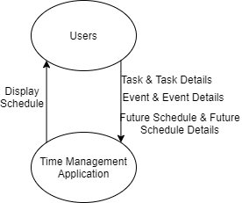
Results & Discussions
System Design: Context Diagram

Slide 34
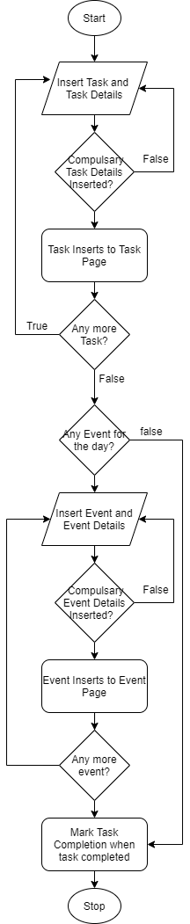
Results & Discussions
System Design: Activity Diagram

Slide 35
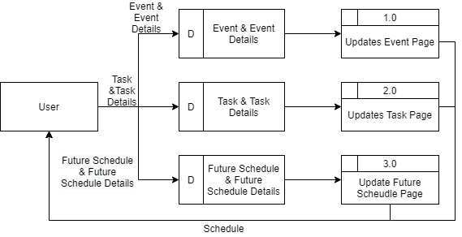
Results & Discussions
System Design: Data Flow Diagram

Slide 36
Results & Discussions
System Implementation: Utilized Tools
Android Emulator
Flutter Framework & Dart Programming Language
Visual Studio Code
Google Firestore

Slide 37
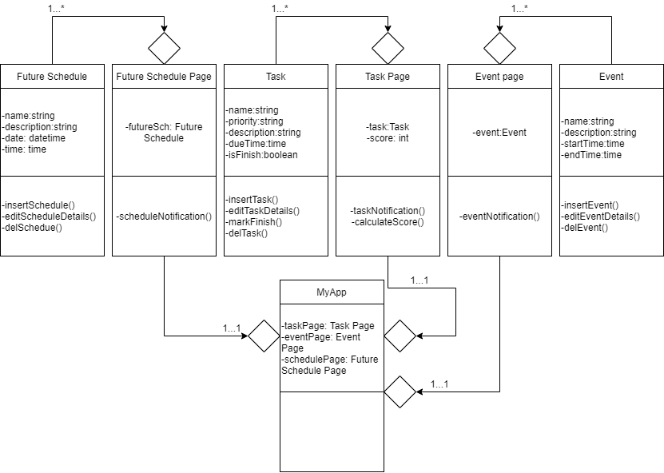
Results & Discussions
System Implementation: Class Diagram

Slide 38
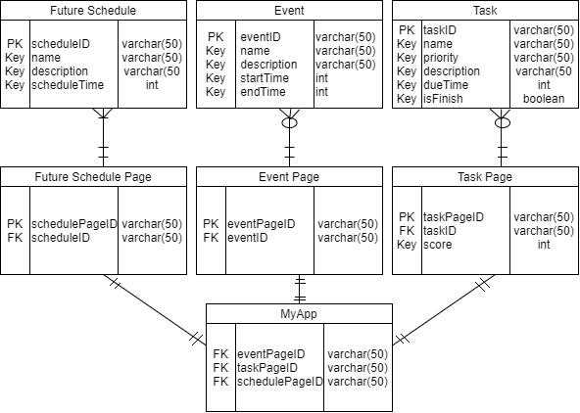
Results & Discussions
System Implementation: Entity Relationship Diagram

Slide 39
Results & Discussions
Step 1: Testing script / prototype will need to be completed.
Step 2: Every function is tested and examined by using the function at least once.
Step 3: The result of the function will be assessed.
Step 4 (optional): If error displayed or result is not within expectation, script will be examined and fixed.
System Testing
Testing is needed to ensure that the system can run smoothly and without any error. In this phase, every function is tested and the result is recorded.

Slide 40
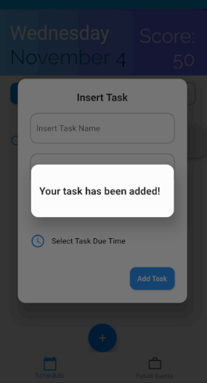
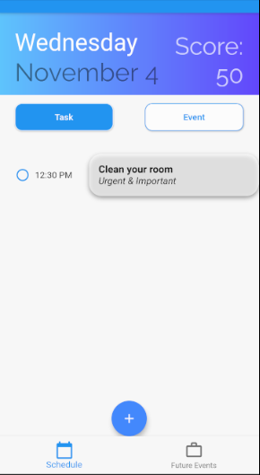
Results & Discussions
System Testing: Functionality Test 1
Objective | User is able to insert task to Task Page successfully.
Steps | User selects the “+” button on Task Page to insert task User inserts the task details correctly User selects the “Insert Task” button
Expected Output | Task Page display a pop-up indicating task is inserted successfully. Task with the inserted information added to the Task Page.
Actual Output | Task Page display a pop-up indicating task inserted successfully. Task with the inserted information added to the Task Page.
Test Result | Success

Slide 41
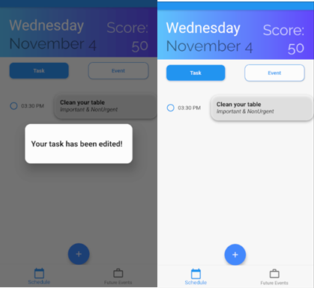
Results & Discussions
System Testing: Functionality Test 2
Objective | User is able to edit the details of selected task
Steps | User long presses the task which needed to be edited User inserts the new task details correctly User selects the “Edit Task” button
Expected Output | Task Page display a pop-up indicating task is edited successfully. Task with the newly inserted information made changes to Task Page.
Actual Output | Task Page display a pop-up indicating task is edited successfully. Task with the newly inserted information made changes to Task Page.
Test Result | Success

Slide 42
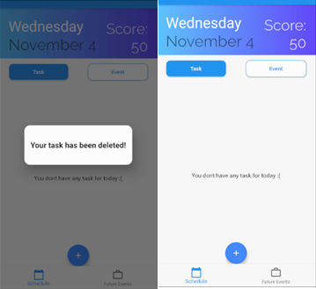
Results & Discussions
System Testing: Functionality Test 3
Objective | User is able to delete selected task.
Steps | User long presses the task which needed to be deleted. User selects the “Delete Task” button.
Expected Output | Task Page display a pop-up indicating task is deleted successfully. Deleted Task removed from Task page.
Actual Output | Task Page display a pop-up indicating task is deleted successfully. Deleted Task removed from Task page.
Test Result | Success

Slide 43
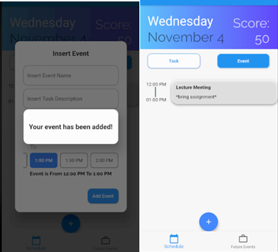
Results & Discussions
System Testing: Functionality Test 4
Objective | User is able to insert event to Event Page.
Steps | User selects the “+” button on Event Page to insert event User inserts the event details correctly User selects the “Insert Event” button
Expected Output | Event Page display a pop-up indicating event inserted successfully Event added to the Event Page.
Actual Output | Event Page display a pop-up indicating event inserted successfully Event added to the Event Page.
Test Result | Success

Slide 44
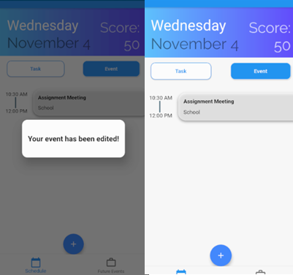
Results & Discussions
System Testing: Functionality Test 5
Objective | User is able to edit the details of selected event
Steps | User long presses the event which needed to be edited User inserts the new event details correctly User selects the “Edit event” button
Expected Output | Event Page display a pop-up indicating task is edited successfully. Task with the newly inserted information made changes to Task Page.
Actual Output | Task Page display a pop-up indicating task is edited successfully. Task with the newly inserted information made changes to Task Page.
Test Result | Success

Slide 45
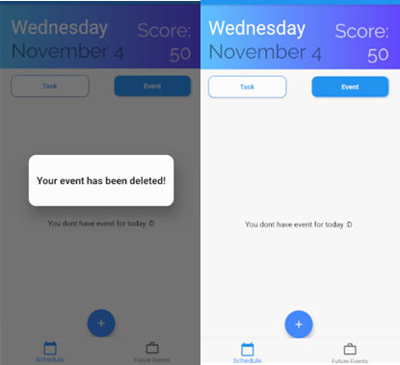
Results & Discussions
System Testing: Functionality Test 6
Objective | User is able to delete selected event.
Steps | User long presses the event which needed to be deleted. User selects the “Delete Event” button.
Expected Output | Event Page display a pop-up indicating event is deleted successfully. Deleted Event removed from Event page.
Actual Output | Event Page display a pop-up indicating event is deleted successfully. Deleted Event removed from Event page.
Test Result | Success

Slide 46
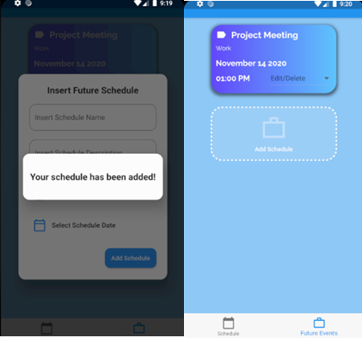
Results & Discussions
System Testing: Functionality Test 7
Objective | User is able to insert event to Event Page.
Steps | User selects the “Add Schedule” button on Future Schedule Page to insert schedule User inserts the event details correctly User selects the “Insert Event” button
Expected Output | Event Page display a pop-up indicating event inserted successfully Event added to the Event Page.
Actual Output | Event Page display a pop-up indicating event inserted successfully Event added to the Event Page.
Test Result | Success

Slide 47
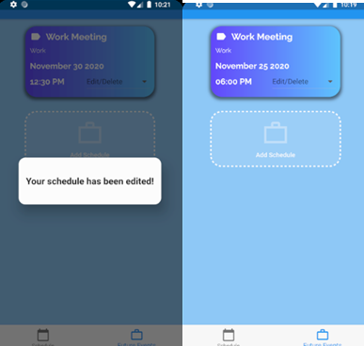
Results & Discussions
System Testing: Functionality Test 8
Objective | User is able to edit the details of selected schedule
Steps | User selects the “Edit/Delete” button on schedule that needed to be edited User inserts the new schedule details correctly User selects the “Edit Schedule” button
Expected Output | Future Schedule Page display a pop-up indicating schedule is edited successfully. Schedule with the newly inserted information made changes to Future Schedule Page.
Actual Output | Future Schedule Page display a pop-up indicating schedule is edited successfully. Schedule with the newly inserted information made changes to Future Schedule Page.
Test Result | Success

Slide 48
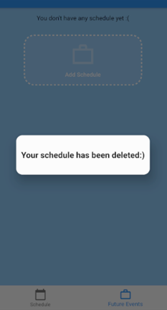
Results & Discussions
System Testing: Functionality Test 9
Objective | User is able to delete selected schedule
Steps | User selects the “Edit/Delete” button on schedule that needed to be delete User selects the “Delete Schedule” button.
Expected Output | Future Schedule Page display a pop-up indicating schedule is deleted successfully. Deleted Schedule removed from Future Schedule page.
Actual Output | Future Schedule Page display a pop-up indicating schedule is deleted successfully. Deleted Schedule removed from Future Schedule page.
Test Result | Success

Slide 49
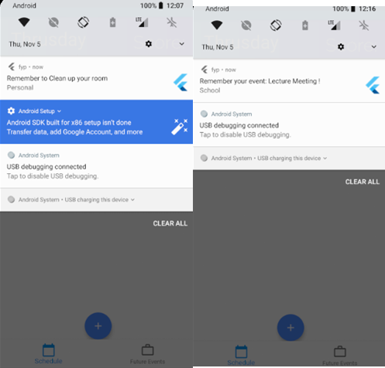
Results & Discussions
System Testing: Functionality Test 10
Objective | User is able to receive notification for Task and Event
Steps | This is an automated function
Expected Output | Notification reminds about Task 15 minutes before Task Due Time. Notification reminds about Event 15 minutes before Event Start Time
Actual Output | Notification reminds about Task 15 minutes before Task Due Time. Notification reminds about Event 15 minutes before Event Start Time
Test Result | Success

Slide 50
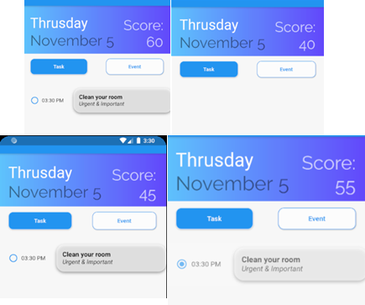
Results & Discussions
System Testing: Functionality Test 11
Objective | Score is calculating correctly various conditions with a default score of 50
Steps | This is an automated function
Expected Output | Score plus 5 when task is marked as completed Score minus 5 when task is failed to complete on time Score plus 10 when the application is used to schedule task Score minus 10 when the application is not used to schedule task
Actual Output | Score plus 5 when task is marked as completed Score minus 5 when task is failed to complete on time Score plus 10 when the application is used to schedule task Score minus 10 when the application is not used to schedule task
Test Result | Success

Slide 51
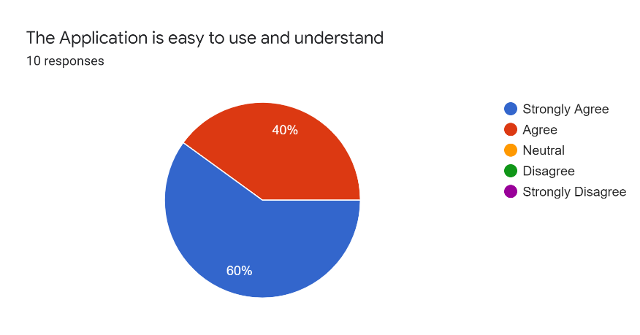
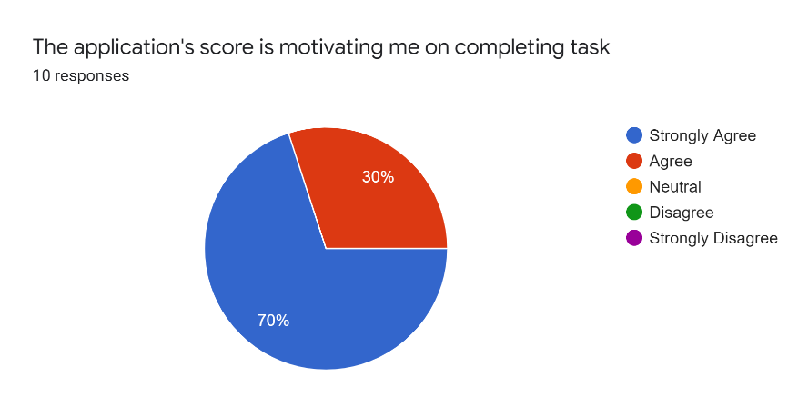
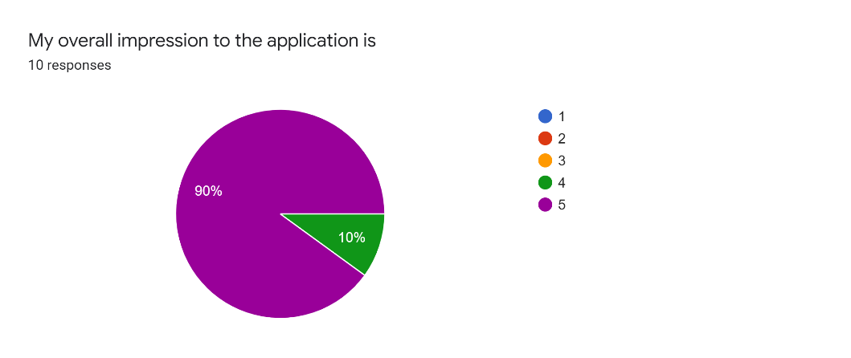
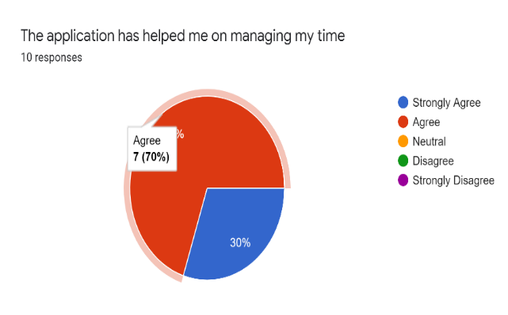
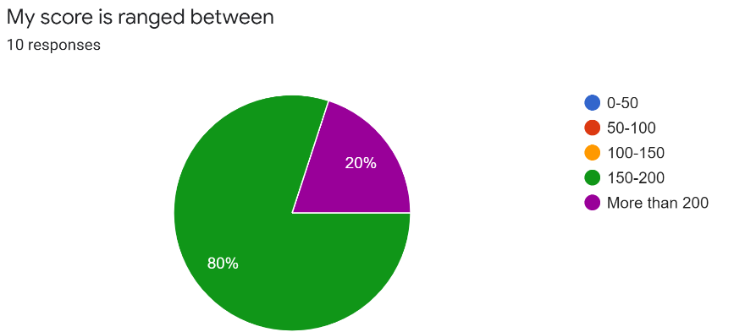
Results & Discussions
System Evaluation
10 testers have been recruited to test out the system
The system has been compiled into an apk file in order for the testers to install on their android devices
Then after 5 days of testing, the feedbacks from the testers were collected

Slide 52
Conclusions
Project summary

Slide 53
Project Summary
It has concluded that this project has achieved every project objective that were defined earlier. it can be said with
confident that the Time Management is able to assist user cultivating time management habit
and manage their time more efficiently. Therefore, the Time Management Application is
successfully on solving procrastination via helping users cultivating time management skill.
Objective | Description | Result
1 | Investigate the technique of solving procrastination by cultivating balance working habit through time management. | Success
Objective | Description | Result
2 | Design said mobile application with the chosen method. | Success
Objective | Description | Result
3 | Produce a full system of said mobile application | Success
Objective | Description | Result
4 | Evaluate the end product functionality and ease of use quality. | Success

Slide 54
Thank you

